Slide 1
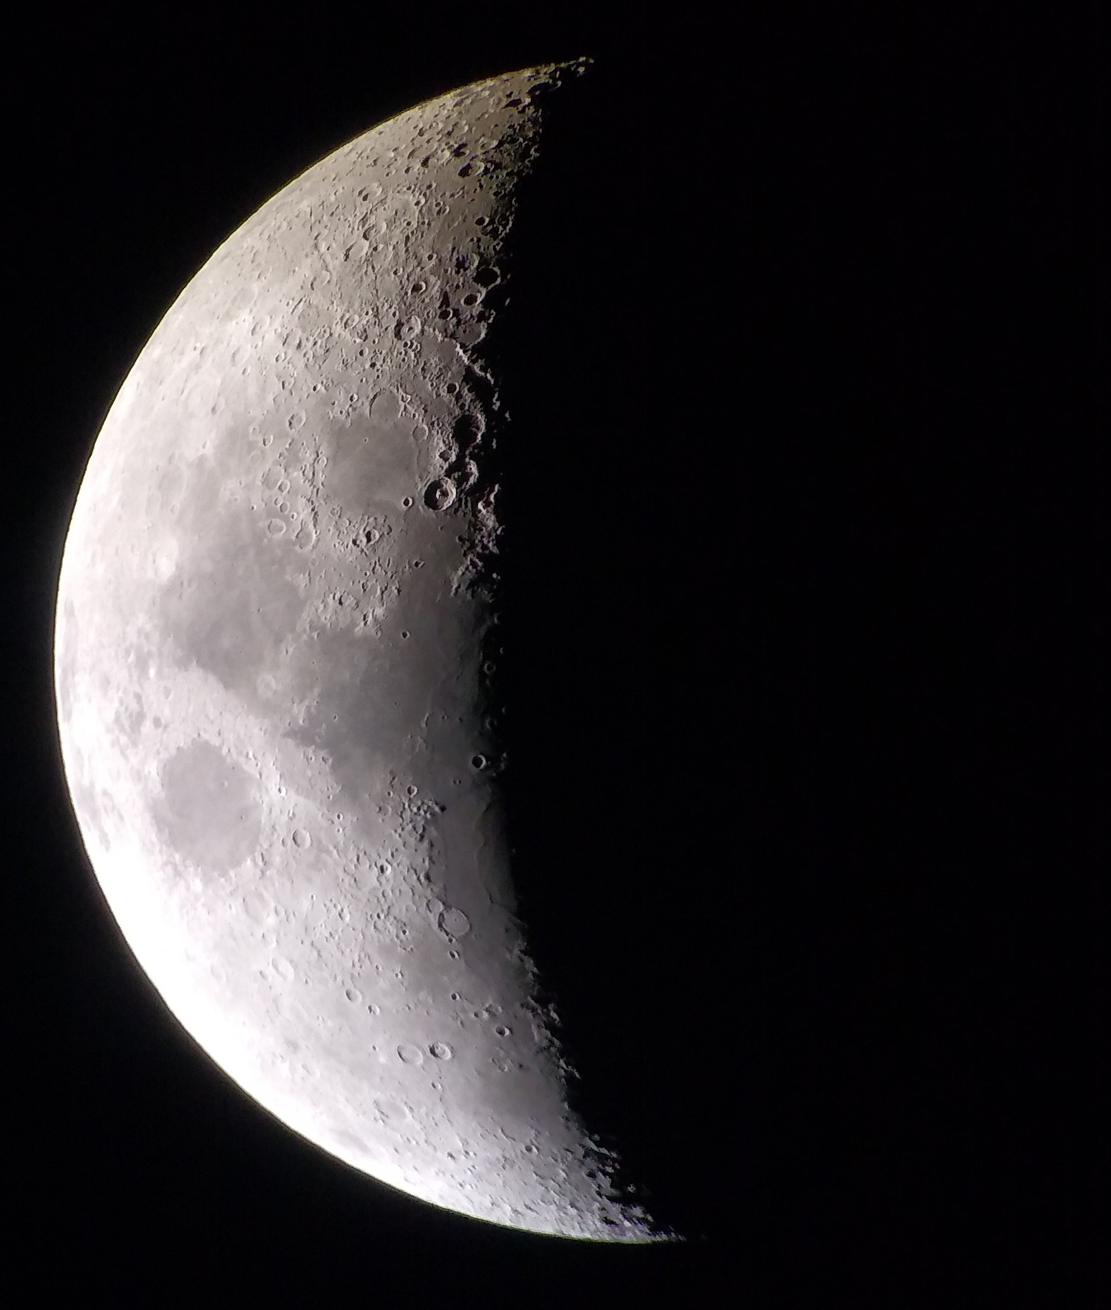
Meeting over MeMoSeE: Near-field and tall structures Monte Carlo & Analytic Approach
Anthony M. DeStefano
NASA/MSFC/EV44 Natural Environments
7/15/2021

Slide 2
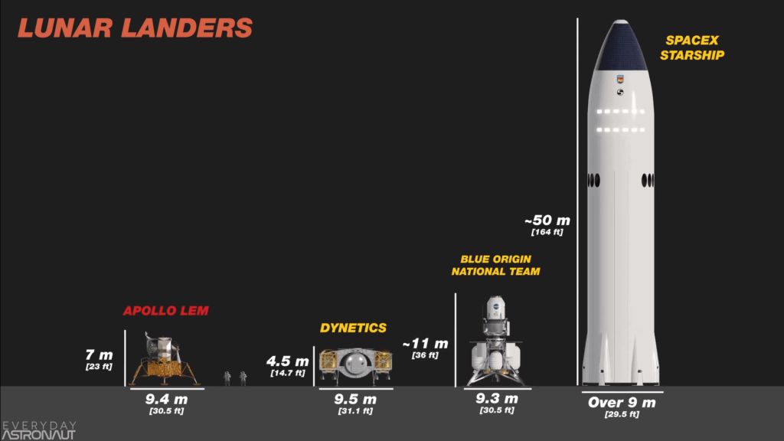


How does lander height affect secondary ejecta?
$Fraction of total ejecta=6.737×{10}^{−4}{height}^{0.3964}$
E.g., Starship receives 2.2x more ejecta flux* than Apollo LEM
Equation valid for lander heights from 6.25m to 400m, with a lander radius of 4.5m
https://everydayastronaut.com/artemis-vs-apollo/
*Assuming isotropic ejecta with a speed distribution $f\left(v\right)∼v^{−α}, α=2.2$

Slide 3
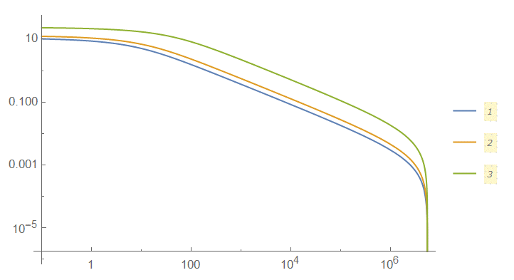

Integral ejecta flux vs. Impact distance
$I_{ejecta flux}\left(d_{I}\right)=\int_{d_{I}}^{πR_{m}}{dx F(x)}$, the integral ejecta flux as a function of impact distance $d_{I}$
$F\left(x\right)=\frac{A}{x^{b}+{\left(\frac{x}{c}\right)}^{d}}$ , the differential ejecta flux as a function of distance $x$
From analytic results, we expect:
$b=\frac{α−1}{2}=0.6$ , and
$d=\frac{α+1}{2}=1.6$
Due to the speed distribution $f\left(v\right)∼v^{−α}, α=2.2$
1: h=7m
2: h=11m
3: h=50m
Integral ejecta flux (fraction of ejecta flux > d_I)
Impact Distance (from lander edge) (m)

Slide 4
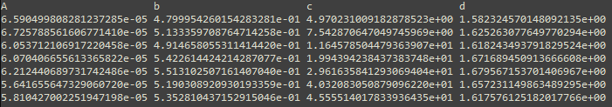
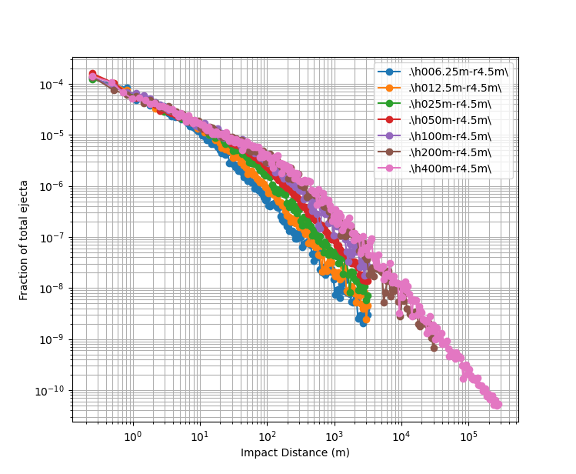
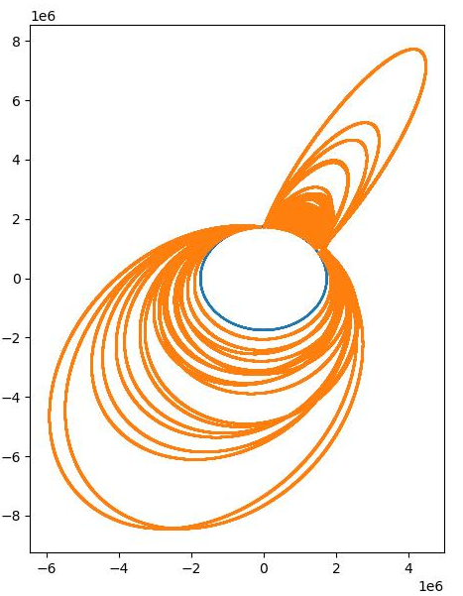
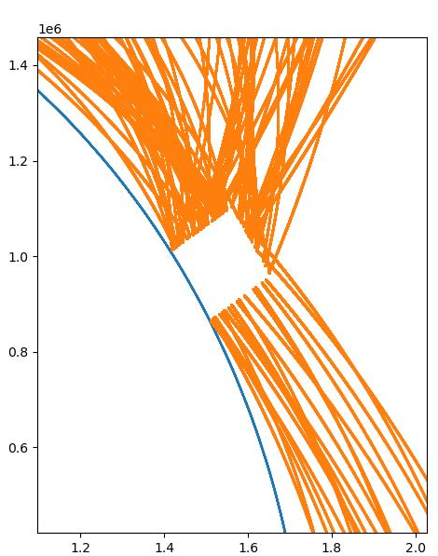


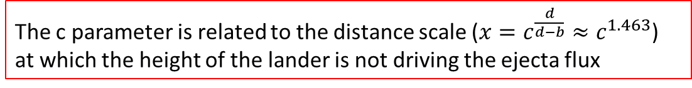

Differential ejecta flux vs. distance
$$F\left(x\right)=\frac{A}{x^{b}+{\left(\frac{x}{c}\right)}^{d}}$$
Various cylindrical lander heights were simulated using Monte Carlo for various impact distances
For simplicity, the simulations used 2D due to the symmetry – off radial hits assumed to have same width as radial width (conservative)
Orbits solved using RKF45 integration of equations of motion (variable time stepping):
$\dot{r}=v$
$\dot{v}=a$
$a=\frac{F}{m}=−\frac{g}{r^{2}} \hat{r}$
MC sims show:
$b∼0.52$ and $d∼1.64$, very close to the analytic estimates!
The c parameter is related to the distance scale ($x=c^{\frac{d}{d−b}}≈c^{1.463}$) at which the height of the lander is not driving the ejecta flux
$$c=1.916∗{height}^{0.5633}$$

Slide 5
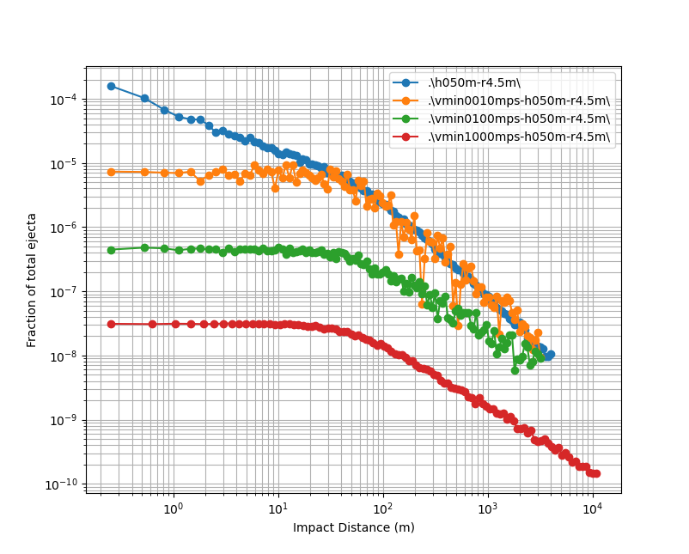
Effects of minimum ejecta speed on differential ejecta flux
Imposing a minimum ejecta speed eliminates the bulk of the ejecta at close distances
Low-energy ejecta (speed and mass) may be irrelevant to the impact risk
Forward work:
How does minimum speed affect integral flux?

